Slide 1

CISC360 Computer Architecture
Lesson 9
CPU Structure and Function

Slide 2
CPU Structure
CPU must:
  Fetch instructions
  Interpret instructions
  Fetch data
  Process data
  Write data
Notes:
22

Slide 3
Registers
CPU must have some working space (temporary storage)
Called registers
Number and function vary between processor designs
One of the major design decisions
Top level of memory hierarchy
Notes:
23

Slide 4

User Visible Registers
General Purpose
Data
Address
Condition Codes
Notes:
24

Slide 5
General Purpose Registers (1)
May be true general purpose
May be restricted
May be used for data or addressing
Data
  Accumulator
Addressing
  Segment
Notes:
25

Slide 6
General Purpose Registers (2)
Make them general purpose
  Increase flexibility and programmer options
  Increase instruction size & complexity
Make them specialized
  Smaller (faster) instructions
  Less flexibility
Notes:
26

Slide 7
How Many GP Registers?
Between 8 - 32
Fewer = more memory references
More does not reduce memory references and takes up processor real estate
See also RISC
Notes:
27

Slide 8
How big?
Large enough to hold full address
Large enough to hold full word
Often possible to combine two data registers
  Single-,double-,extended-precision FP
Notes:
28

Slide 9
Condition Code Registers
Sets of individual bits
  e.g. result of last operation was zero
Can be read (implicitly) by programs
  e.g. Jump if zero
Can not (usually) be set by programs
Notes:
29

Slide 10
Control & Status Registers
Program Counter
Instruction Decoding Register
Memory Address Register
Memory Buffer Register
Notes:
30

Slide 11
Program Status Word
A set of bits
Includes Condition Codes
Sign of last result
Zero
Carry
Equal
Overflow
Interrupt enable/disable
Supervisor
Notes:
31

Slide 12
Supervisor Mode
Intel/Multics ring zero
Kernel mode
Allows privileged instructions to execute
Used by operating system
Not available to user programs
Notes:
32

Slide 13
Other Registers
May have registers pointing to:
  Process control blocks (see O/S)
  Interrupt Vectors (see O/S)
N.B. CPU design and operating system design are closely linked
Notes:
33

Slide 14

Example Register Organizations

Slide 15
Foreground Task
QUIZ 3 – TAKE-HOME Quiz
  Visit a manufacturers’ web site and prepare a document describing the CPU structure and function of a processor (microprocessor, workstation, mainframe) OTHER THAN the 80x86 series of machines
Due on 29 November (after Thanksgiving)
Notes:
34

Slide 16
Indirect Cycle
May require memory access to fetch operands
Indirect addressing requires more memory accesses
Can be thought of as additional instruction subcycle

Slide 17
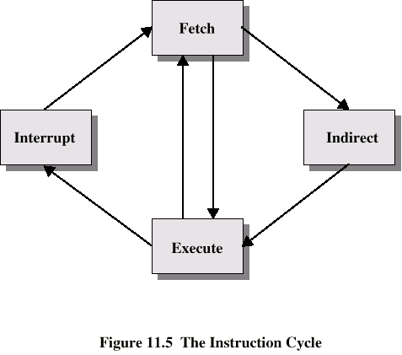
Instruction Cycle with Indirect

Slide 18

Instruction Cycle State Diagram

Slide 19
Data Flow (Instruction Fetch)
Depends on CPU design
In general:
Fetch
  PC contains address of next instruction
  Address moved to MAR
  Address placed on address bus
  Control unit requests memory read
  Result placed on data bus, copied to MBR, then to IR
  Meanwhile PC incremented by 1

Slide 20
Data Flow (Data Fetch)
IR is examined
If indirect addressing, indirect cycle is performed
  Right most N bits of MBR transferred to MAR
  Control unit requests memory read
  Result (address of operand) moved to MBR

Slide 21

Data Flow (Fetch Diagram)

Slide 22

Data Flow (Indirect Diagram)

Slide 23
Data Flow (Execute)
May take many forms
Depends on instruction being executed
May include
  Memory read/write
  Input/Output
  Register transfers
  ALU operations

Slide 24
Data Flow (Interrupt)
Simple
Predictable
Current PC saved to allow resumption after interrupt
Contents of PC copied to MBR
Special memory location (e.g. stack pointer) loaded to MAR
MBR written to memory
PC loaded with address of interrupt handling routine
Next instruction (first of interrupt handler) can be fetched

Slide 25

Data Flow (Interrupt Diagram)

Slide 26
Prefetch
Fetch accessing main memory
Execution usually does not access main memory
Can fetch next instruction during execution of current instruction
Called instruction prefetch
Notes:
36

Slide 27
Improved Performance
But not doubled:
  Fetch usually shorter than execution
    Prefetch more than one instruction?
  Any jump or branch means that prefetched instructions are not the required instructions
Add more stages to improve performance
Notes:
37

Slide 28
Pipelining is Natural!
Laundry Example
Ann, Brian, Cathy, Dave
each have one load of clothes
to wash, dry, and fold
Washer takes 30 minutes
Dryer takes 30 minutes
“Folder” takes 30 minutes
“Stasher” takes 30 minutes
to put clothes into drawers
A
A
B
C
D

Slide 29
Sequential Laundry
6 PM
7
8
9
10
11
12
1
2 AM
T
a
s
k
O
r
d
e
r
30
30
30
30
30
30
30
30
30
30
30
30
30
30
30
30
Time
A
B
C
D
Sequential laundry takes 8 hours for 4 loads

Slide 30
Pipelined Laundry: Start work ASAP
6 PM
7
8
9
10
11
12
1
2 AM
30
30
30
30
30
Time
T
a
s
k
O
r
d
e
r
30
30
A
B
C
D
Pipelined laundry takes 3.5 hours for 4 loads!

Slide 31
Why Pipeline?
Suppose we execute 100 instructions
Single Cycle Machine
  45 ns/cycle x 1 CPI x 100 inst = 4500 ns
Multicycle Machine
  10 ns/cycle x 4.6 CPI (due to inst mix) x 100 inst = 4600 ns
Ideal pipelined machine
  10 ns/cycle x (1 CPI x 100 inst + 4 cycle drain) = 1040 ns

Slide 32
Pipelining
Fetch instruction
Decode instruction
Calculate operands (i.e. EAs)
Fetch operands
Execute instructions
Write result
Overlap these operations
Notes:
38

Slide 33
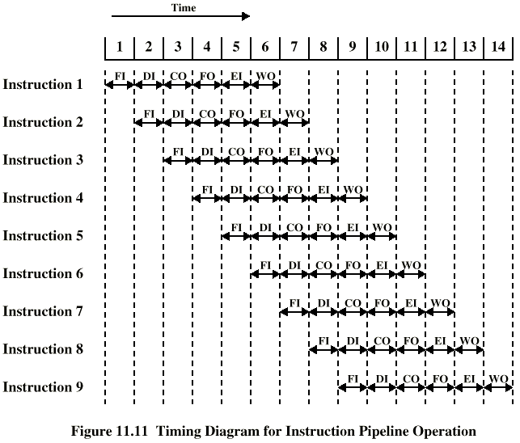
Timing of Pipeline
Notes:
39

Slide 34
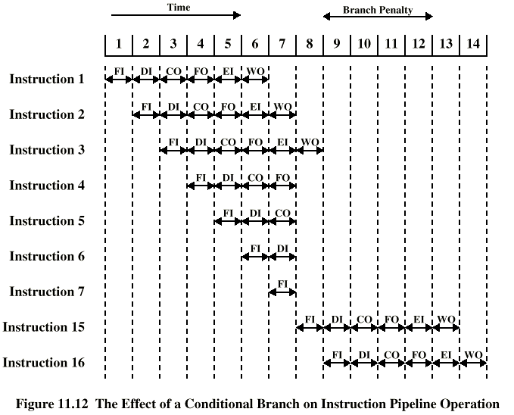
Branch in a Pipeline
Notes:
40

Slide 35
Dealing with Branches
Multiple Streams
Prefetch Branch Target
Loop buffer
Branch prediction
Delayed branching
Notes:
41

Slide 36
Multiple Streams
Have two pipelines
Prefetch each branch into a separate pipeline
Use appropriate pipeline
Leads to bus & register contention
Multiple branches lead to further pipelines being needed
Notes:
42

Slide 37
Prefetch Branch Target
Target of branch is prefetched in addition to instructions following branch
Keep target until branch is executed
Used by IBM 360/91
Notes:
43

Slide 38
Loop Buffer
Very fast memory
Maintained by fetch stage of pipeline
Check buffer before fetching from memory
Very good for small loops or jumps
c.f. cache
Used by CRAY-1
Notes:
44

Slide 39
Branch Prediction (1)
Predict never taken
  Assume that jump will not happen
  Always fetch next instruction
  68020 & VAX 11/780
  VAX will not prefetch after branch if a page fault would result (O/S v CPU design)
Predict always taken
  Assume that jump will happen
  Always fetch target instruction
Notes:
45

Slide 40
Branch Prediction (2)
Predict by Opcode
  Some instructions are more likely to result in a jump than thers
  Can get up to 75% success
Taken/Not taken switch
  Based on previous history
  Good for loops
Notes:
46

Slide 41
Branch Prediction (3)
Delayed Branch
  Do not take jump until you have to
  Rearrange instructions
Notes:
47

Slide 42
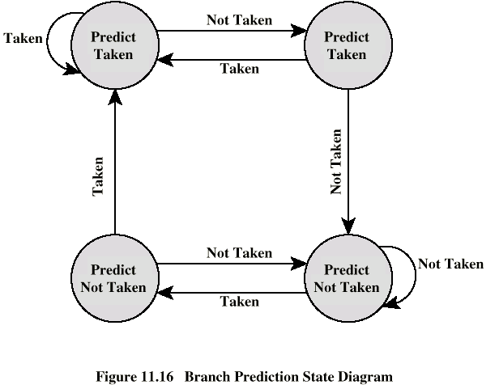
Branch Prediction State Diagram

